Slide 1
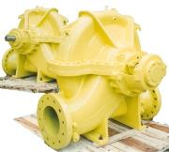
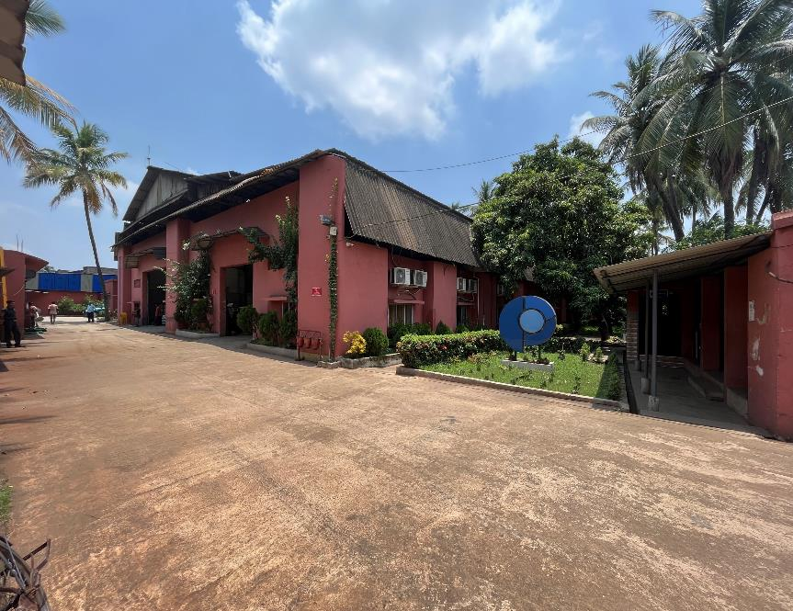

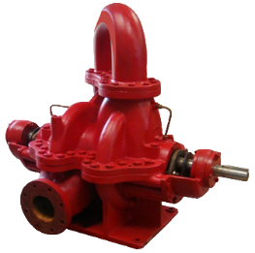
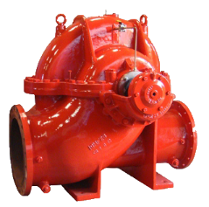



PUMPSENSE
Company Presentation

Slide 2

PUMPSENSE – BACKGROUND
Himadri Sen started Allied Centrifugal Pumps (ACP) in 1995 atter working for 20 years in the pump Industry - Mather & Platt and Weir Pumps.
In addition to ACP’s own line of products, design & development services were offered to major customers- Peerless Pumps, WILO and CounterFire.
ACP’s major product line included pumps for air conditioning, NFPA 20 fire pumps, pumps for industrial and urban water supply and marine fire pumps.
ACP merged with WILO in 2005. In 2008, the company achieved a turnover of US$ 6.0 million in exports.
In 2009, Himadri Sen handed over the management of ACP to Mather & Platt (A WILO group company) to start Pumpsense.

Slide 3
PUMPSENSE – VISION
CORE VALUES | The purpose of our business is not merely customer satisfaction and maximizing shareholder value. Wellbeing, growth and happiness of the individuals working for us is more important than profitability. Practical implication of this is that we focus on education, safety and health of our employees on a continual basis. Also, importantly, we will remain a secular, non-discriminatory, open organization where there is no gender, religious or ethnic biases.
RESPONSIVENESS, OPENESS, KINDNESS AS BASIS OF GROWTH | Since we manufacture engineered products, we need to interact with the customers on a protracted basis. While most companies depend on automated responses, we try to personalize our interaction with our customers. Speed, quality, and sincerity of our response should differentiate us from our competitors. In addition, we try to be open to our customers and to our suppliers and treat everyone with kindness and empathy. We are advocating a contrarian approach to system driven/AI regulated interface with the customers and business associates. Ours is a humane, open and kind organization.

Slide 4
PUMPSENSE – VISION
GROW BY DOING MORE OF WHAT WE HAVE LEARNT TO DO WELL | This requires sustained marketing efforts. We will focus on a limited number of products and build them for global market. We will continue to find OEM partners but expand our reach to include actual users of our products.
LEARNING, DISSENT, ARGUMENTATION | Our knowledge and skills should take us ahead in our business and these will be used as primary growth tools. Knowledge in scientific field is acquired only where independent thinking is permitted and dissent and argumentation are actively encouraged. We encourage development of a deep commitment to learning.
QUALITY COMES FROM DEEP CARING | We constantly struggle with quality, we analyze, dissect, and try to find root causes of quality problems. Quality comes from deep caring for what we do. Our challenge is to bring in a sense of firm commitment and caring for the work that we do.

Slide 5
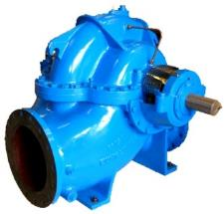
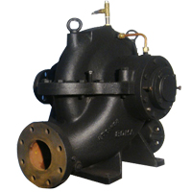

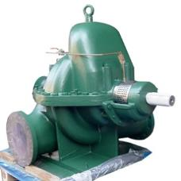

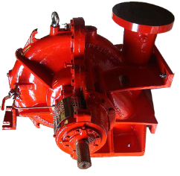
PRODUCTS – SPLIT CASE
Single Stage Industrial : HS
Single Stage Compact Industrial : CSC
Single Stage Fire : HF
Two Stage Industrial : HST
Marine External Fire : SF & SFM
Two Stage Fire : HFT

Slide 6
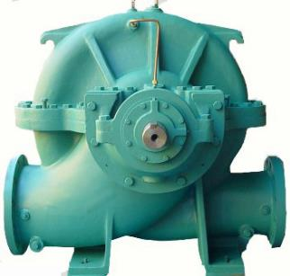
PRODUCTS – SPLIT CASE
RANGE OF OUR SPLIT-CASE PUMPS:
Flow: 20 M3/Hr – 4500 M3/Hr
Head: 3 M – 350 M
Speed: Up to 3600 RPM
FEATURES:
Optimum efficiency.
Low NPSHr.
Stable characteristics.
Over 86 sizes ensure optimum selection for all duties.
Quick customization possible to meet special system requirements.
High head units have double volute casings to reduce radial thrust.
PRODUCT VARIANTS:
Single Stage Pumps
Two Stage Pumps
Packed Gland Pumps
Mechanical Seal Fitted Pumps
Side Suction – Side Delivery Pumps
Side Suction – Top Delivery Pumps
Bottom Suction – Top Delivery Pumps
Vertically Mounted Pumps
And more..

Slide 7
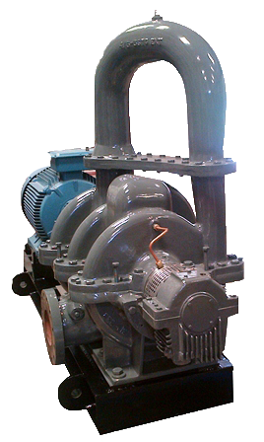
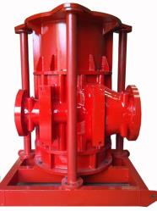
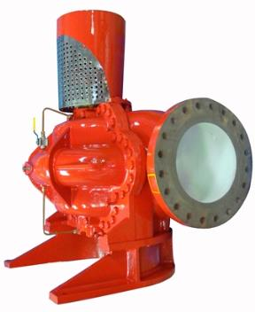
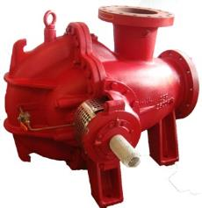
ENGINEERED SPLIT CASE PRODUCTS
Various
Suction/
Delivery Orientations
Special 3 stage design

Slide 8
SPLIT CASE PRODUCTS COMPETITIVENESS
Our range of split-case pumps is one of the most comprehensive in the industry.
For an idea, we have made a comparison between our HS range and the corresponding
split-case ranges of
Paco (Grundfos), KSB, & SPP (KBL).

Slide 9
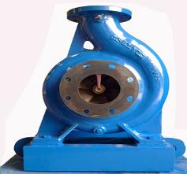
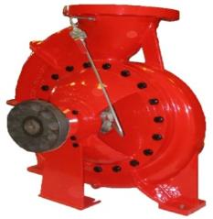
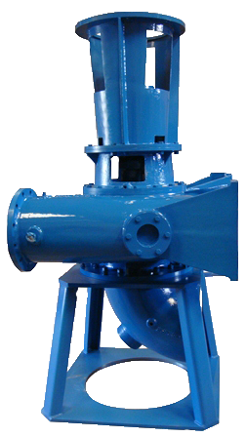
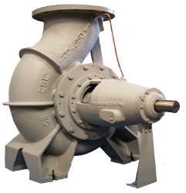
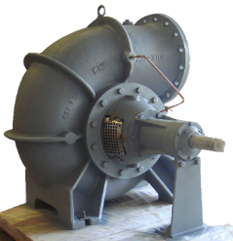
PRODUCTS – END SUCTION
ISO 2858 16 bar back pullout : ES
Compact Marine External
Fire : ESF
Dry Pit Sewage : SW
Large End Suction : ESL
Mixed Flow : EMF

Slide 10
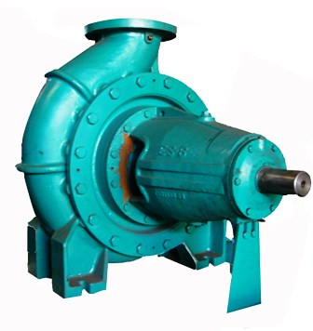
PRODUCTS – END SUCTION
RANGE OF OUR END SUCTION PUMPS:
Flow: 10M3/Hr– 3800M3/Hr
Head: 3M – 250M
Speed: Up to 3600 RPM
FEATURES:
• Small end suction range conforms to ISO 2858/ ISO 5199.
• Optimized for flow & Efficiency
• Efficiency as per Hydraulic Institute & Europump Norms.
• Customized units for higher speed and special applications.
• Many material and flange options.
PRODUCT VARIANTS:
Small End Suction Pumps – ISO 2858.
Large End Suction Pumps – up to 16” size. (ISO 5199)
Packed Gland Pumps.
Mechanical Seal Fitted Pumps.
Centreline Mounted Pumps - OH2
Vertically mounted – OH3A
Strengthened Bearing Pumpss.
Bottom Suction – Top Delivery Pumps etc.

Slide 11
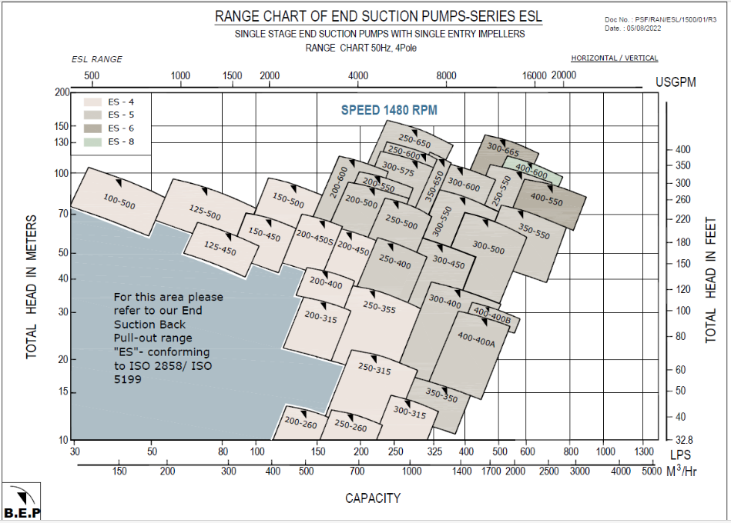
PRODUCTS
End Suction Range Charts
One of the largest range in the world up to 3500M3/hr.
Large End Suction
at 1480 RPM

Slide 12
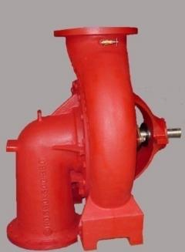
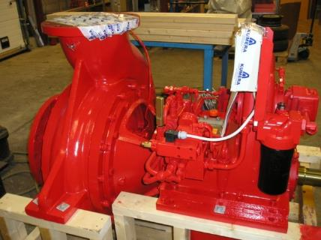
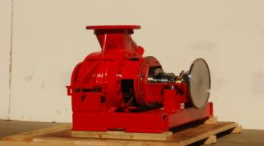
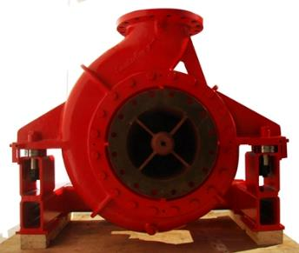
ENGINEERED END SUCTION PRODUCTS
Bottom Suction / Top Delivery
Gear Mounted
Clutch Mounted
Centerline Mounted

Slide 13
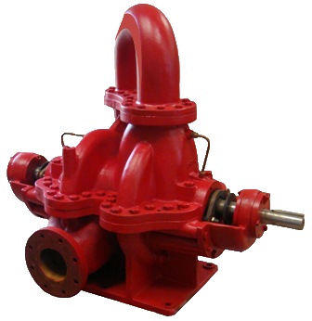
PRODUCTS – NFPA 20/LISTED FIRE PUMP
RANGE OF OUR NFPA-20 FIRE PUMPS:
Flow: 150 USGPM – 4,000 USGPM
Head: 120 ft – 1500 ft
Speed: Up to 3600 RPM
FEATURES:
• NFPA-20 compliant.
• Large range of UL Listed / FM Approved pumps.
• Stable H-Q curve.
• 15 feet suction lift capability at 150% flow.
• Increased mechanical reliability.
• Optimized for driver rating.
PRODUCT VARIANTS:
Single Stage & Two-Stage Split Case Fire Pumps
End Suction Fire Pumps
Ships’s External Fire-fighting (FiFi) Pumps
Various Suction & Delivery Flange Orientations
Horizontal & Vertical Execution
Customized Design for Special Requirements – Vibration Isolation, Drop-in replacement, etc.

Slide 14
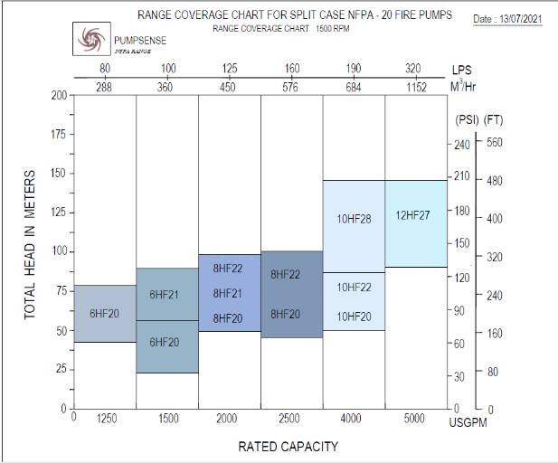
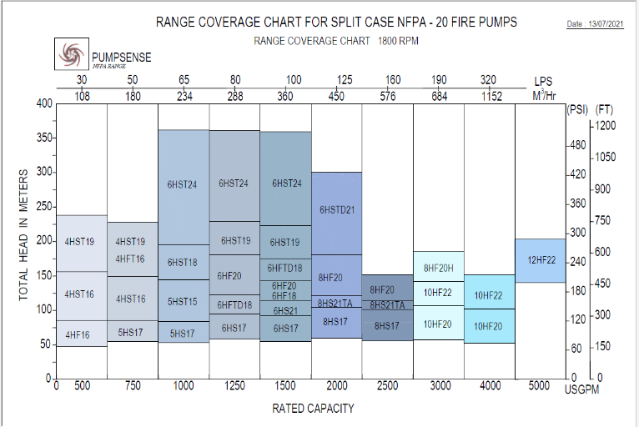
PRODUCTS
Range Chart – 1500/1800 RPM
Large coverage range up to 5000 USGPM- NFPA20 fire pumps

Slide 15
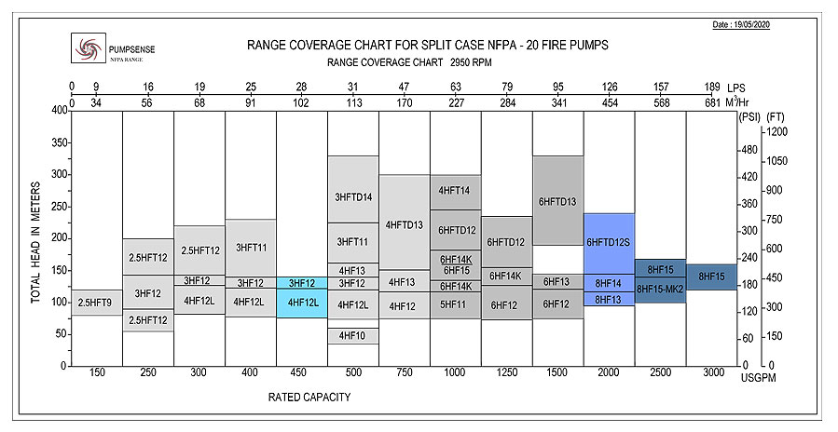
PRODUCTS
Range Chart – 2950 RPM

Slide 16
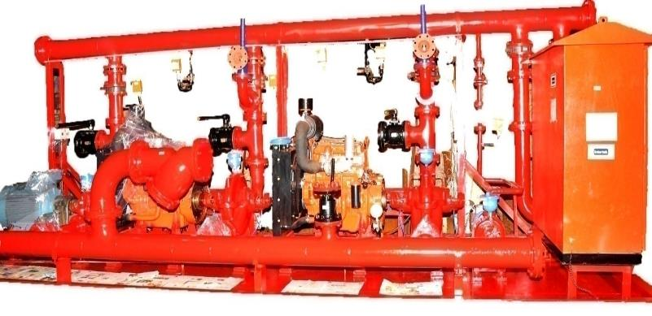
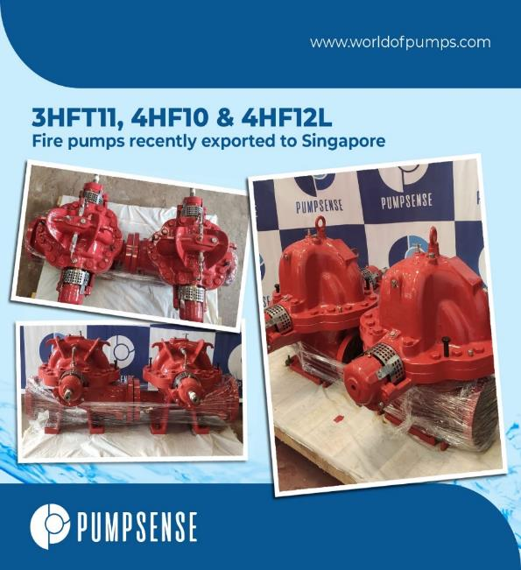
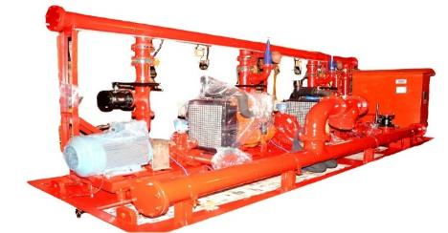
ENGINEERED NFPA 20 PRODUCTS
Fire pump skid developed for Saudi Arabia

Slide 17
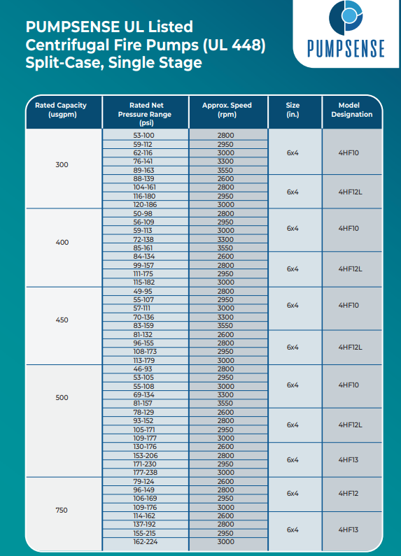
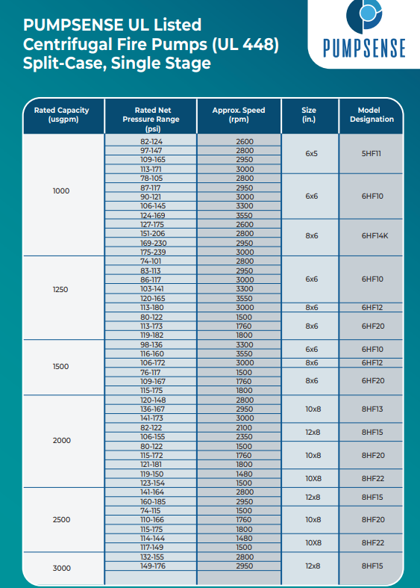


Slide 18
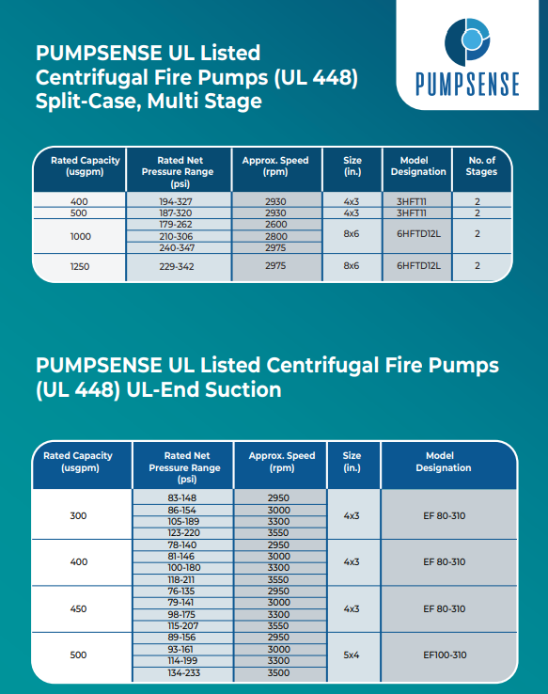
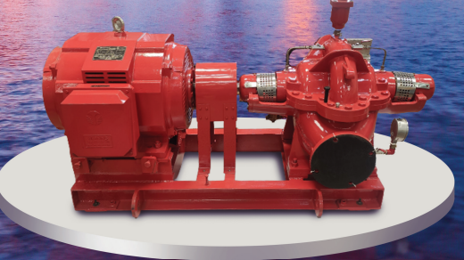
UL Listed pump models: 21Nos.

Slide 19
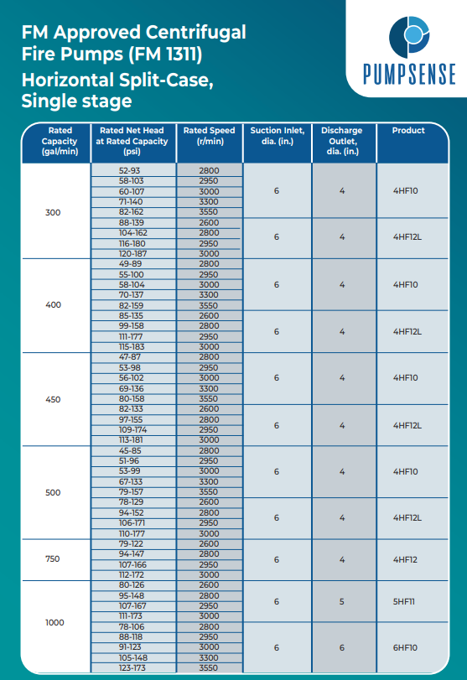
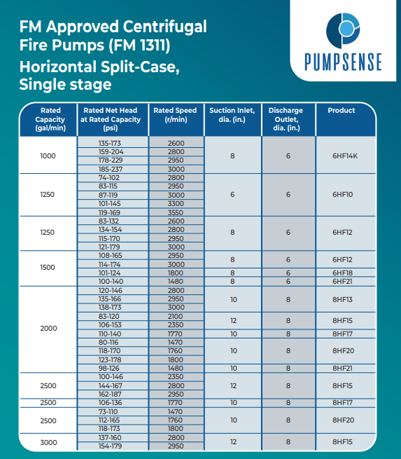


Slide 20
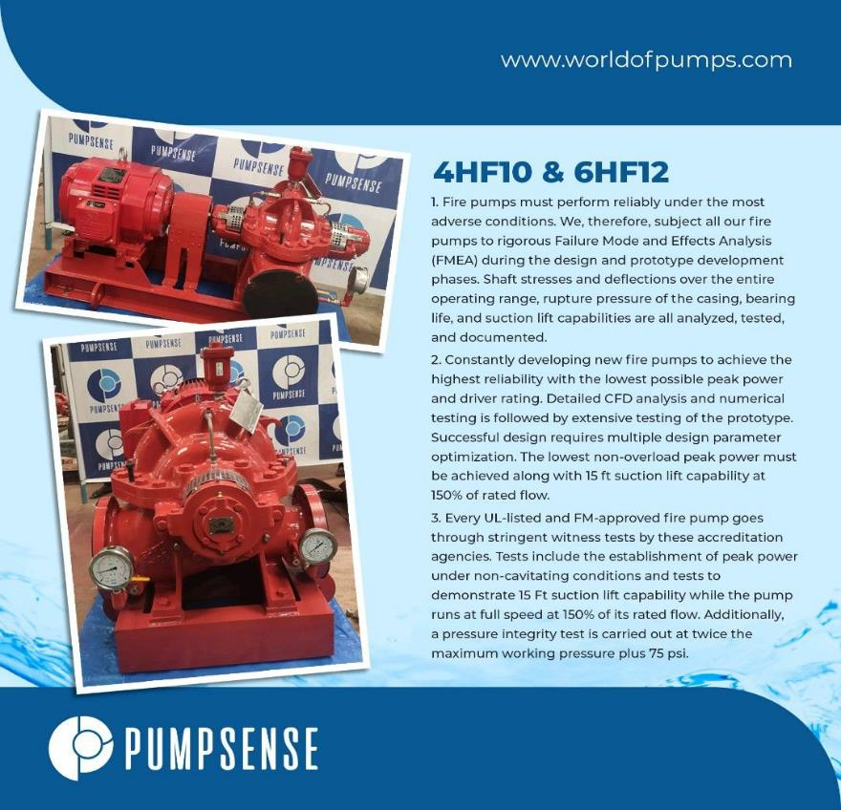
FM approved pump models: 15Nos.

Slide 21
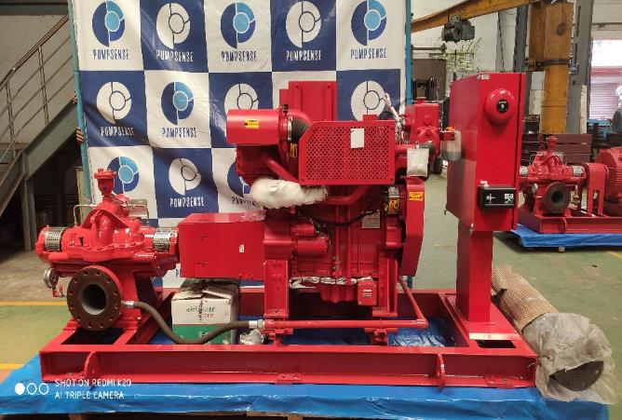
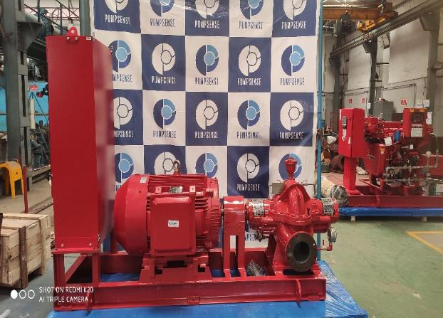
ENGINEERED LISTED PRODUCTS
Diesel Engine Driven
Electric Motor Driven
UL FM Set

Slide 22
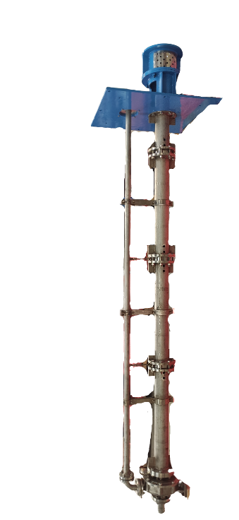
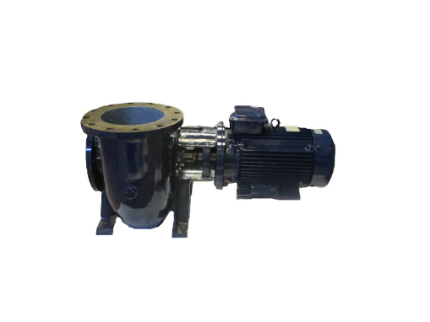
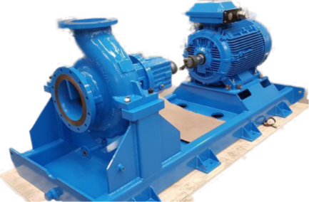
SPECIAL PRODUCTS
Close coupled pump (OH7) for fish farming
Centreline mounted (OH2) Pump
Vertical Sump Pump (VS4)

Slide 23
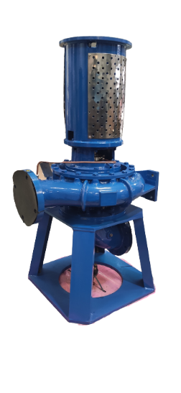
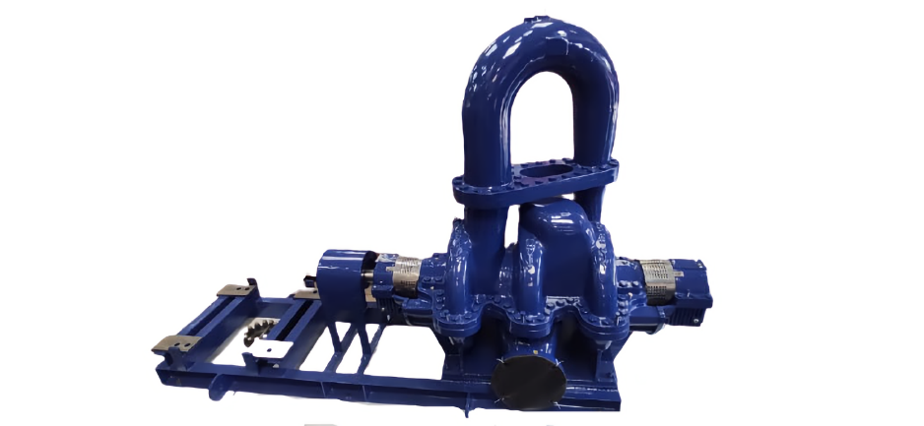
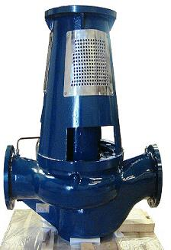
SPECIAL PRODUCTS
Vertical End Suction Pump (OH3A)
3-stage Split-case Pump (BB3)
Vertical Inline Pump (OH3)

Slide 24

SERVICES
Refurbishment Of Centrifugal Pumps
Importance of refurbishment - Improvement of pump reliability, restoring performance, energy optimization, eliminating expensive replacements, lowering carbon foot print
Scope of refurbishment work - Site visit to understand the pumping system, user requirement and history / diagnosis of problems; Transportation of pump to the factory, detailed inspection, diagnostic report including suggestions for performance and reliability improvement, Engineering & rapid production of required parts, reassembly, pressure test & performance test, submission of QA and test documents, Transportation back to the user site, help in commissioning the refurbished unit
Augmented Refurbishment - Problem diagnostics, System Analysis, Energy Audit, Retrofit & Upgrades, Drop in replacements, CM enhancements including system review, MOC alterations, Sealing system review

Slide 25





Refurbishment Of Centrifugal Pumps- Customers in India

Slide 26
SERVICES – RETROFIT & UPGRADES
Volute throat cut back.
Under file impeller vanes at outlet.
Cut back impeller vanes at inlet.
Reduce impeller diameter.
Restore wear ring clearance.
Polish vane passage.
Increase impeller width.
Decrease no. of vanes.
Stuffing box conversion : Packed gland to mechanical seal.
Power end conversion of end suction process pumps.
Rebuilding old or worn out pumps: Matching interface dimensions, footprint, hydraulic performance
Customer | Pump Description | Pump Type | Component | Capacity | Head | RPM | Motor Rating | Remarks
Indira Gandhi Water Treatment Plant, Kolkata Municipal Corporation | Mather & Platt UK-33/36 Lonovane | Split Case Single Volute | Rotating Element | 9082 m³/hr. | 15 m | 370 | 472 kw | Raw Water Lifting Pump
TISCO-CP 4B/CP 5B | Mather & Platt -350/450 CST | Split Case Double Volute | Rotating Element | 1500 m³/hr. | 60 m | 1480 | 400 kw | Pumps having prominent cavitation noise and vibration
Haldia Petrochem. | Sulzer API 610 ZE Process | API- End Suction | Impeller | 100 m³/hr. | 110 m | 2950 | 30 kw | Two Pumps
UPGRADE SERVICES OFFERED

Slide 27

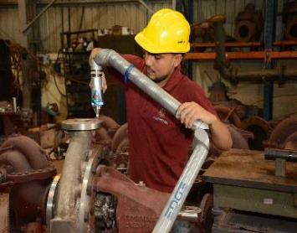
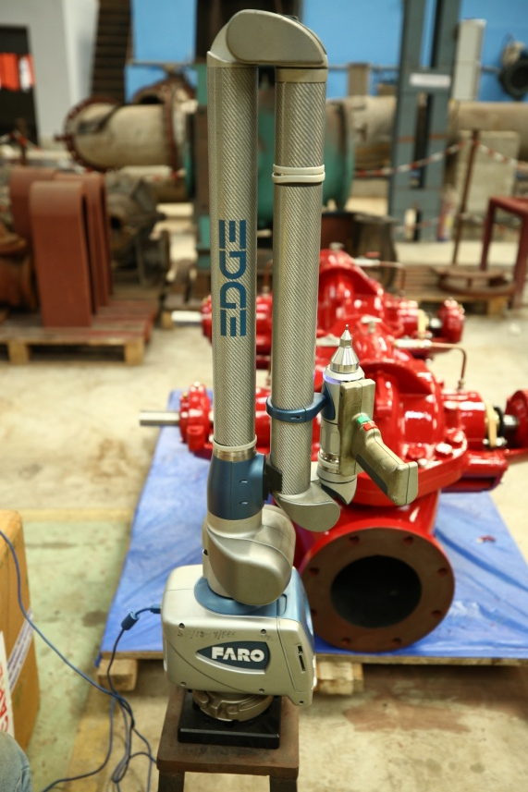
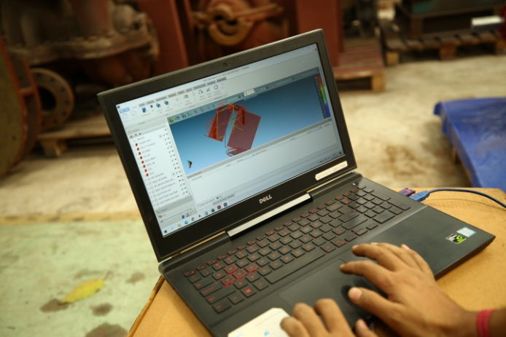
Services-Highlights Of Pumpsense Drop In
The following shall remain identical to the existing installation for fast and economical replacement:
  Foot-print
  Interface dimensions
  Driver
  Foundation
  Piping
Drop-in replacements that can be offered include, but not limited to the following iconic ranges :
  Mather & Platt – Lonovane and Medivane
  Worthington – LN & LR
  Weir – Uniglide & Duoglide
High Accuracy Dimensional Check Using Faro Arm

Slide 28
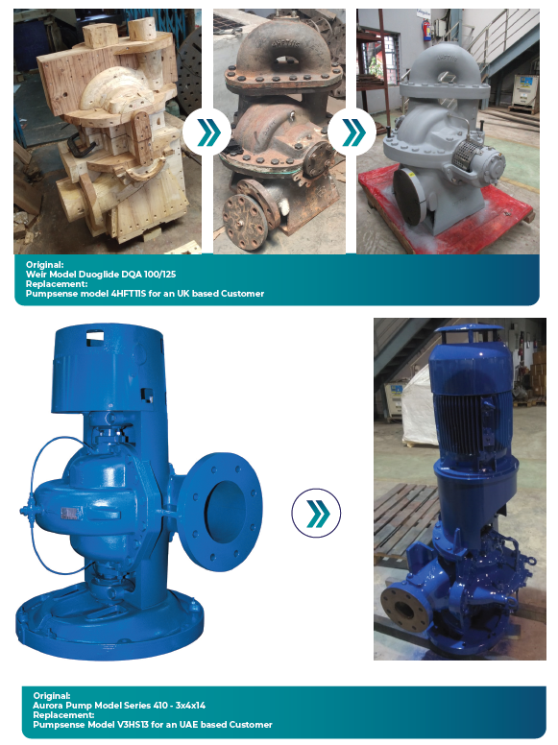

Services-Experience of Drop In Replacement

Slide 29

SERVICES - TRAINING
2 days/ 4 days training & workshop sessions are held for pump professionals.
Session covers all fundamental topics on centrifugal pumps including latest developments & practices in the industry.
Specialised training sessions are also provided for Process Industry on API Pumps, firefighting Industry on NFPA20 Pumps, etc.

Slide 30

FACILITIES – FACTORY PLAN
TOTAL AREA- 40000 SQ. FT

Slide 31






FACILITIES – IN-HOUSE & SUB CONTRACTED
Patterns & Pattern Shop
Casting & Foundry
Machining & machine shop

Slide 32




FACILITIES – IN HOUSE
Assembly Area
Factory
Bird’s eye view
Green Verge

Slide 33



FACILITIES – IN HOUSE
Split-Case Assembly
End Suction Assembly

Slide 34




FACILITIES – IN HOUSE
Canteen
Dormitory

Slide 35





FACILITIES – STORES

Slide 36





FACILITIES – IN HOUSE
Power
Equipment
Material Handling
Equipment

Slide 37



FACILITIES – TEST BED
Hydraulic Institute Test Laboratory Approval for Pumpsense, a first for South & South-East Asia
Test Bed Highlights

Slide 38




State-of-the art – Test Facility
Performance Test Bed
Firm Foundation for pump base to limit vibration
Data Acquisition - SCADA
Large End Suction Pump Testing

Slide 39



FACILITIES – TEST BED
Hydrostatic Pressure Test Bed

Slide 40



NON-DESTRUCTIVE TESTING
Vibration Analysis
Ultrasonic Testing
Checking internal finish - Video Bore Scope

Slide 41



NON-DESTRUCTIVE TESTING
Dye Penetrant Testing
Dry Film Thickness Testing
Impeller Unbalance Testing

Slide 42

DIMENSIONAL INSPECTION
Dimensional Check – Coordinate Measuring Machine
Faro Arm

Slide 43

QUALITY ASSURANCE
S. No. | List Of Quality Documents
1. | Ultrasonic Certificate for shaft
2. | Material Test Certificate for major components:
2.1 | Casing
2.2 | Impeller
2.3 | Shaft
2.4 | Wear ring
3. | Dynamic Balancing Certificate
4. | Performance Test Certificate
5. | As built GA Drawing
6. | Hydrostatic Test Certificate
7. | Seal Integrity Test Certificate
Performance Test Certificate

Slide 44



PRODUCT DEVELOPMENT CAPABILITIES
14HS30 - These pumps are designed for a flow of 600 l/s at 170M head while running at 1500 RPM driven by 1.5 MW Diesel engines. We have built eleven pumps in all for a Government of Thailand project. Replacing KSB pumps at site, the pump was custom designed for the present application and went through extensive CFD analysis and numerical testing, before the first prototype was built.

Slide 45


PRODUCT DEVELOPMENT CAPABILITIES
Original GA
Replacement GA – Identical feet 14HS30

Slide 46






DESIGN STREGTH
Design Analysis for
Three Stage Pumps
Complete Domain
Volute Mesh
1st Stg Impeller
2nd Stg Impeller
3rd Stg Impeller

Slide 47

DESIGN STREGTH
Pressure Pulsation Analysis of Staggered Blade Impellers
Pressure Pulsation Animation
Pressure pulsation at two adjacent points near cutwater

Slide 48





EXPERIENCE
MARS Project – 24 Pumps

Slide 49



EXPERIENCE
Main Fire pump model V10HS22 supplied with
Support rods to transmit 3.6 ton 550KW motor load to the baseplate
Vertical booster pump model V12HS18 supplied with integrated motor stool cum bearing bracket to cater to smaller hydraulic motor mounting flange outer diameter
44 Nos. Close-coupled aquaculture pumps of size 300x300x296.5 supplied to an OEM in Western Europe

Slide 50



EXPERIENCE
Three Stage Condensate Extraction Pump for 20MW captive power Plant in a steel plant. The extraction pump has a double entry first stage impeller with two single entry impellers back to back on either side of it. Arrangement ensures low NPSH and pressurized stuffing boxes.
2 x Vertical 550KW electric motor driven fire pump model V10HS27 supplied in Bronze Gunmetal casing, Ni Al Bronze impeller, duplex SS shaft and Monel Internals supplied to a shipyard in China.

Slide 51




EXPERIENCE
Bow Monitor Pump V6HS21 in special purpose material (All Duplex Duplex Stainless steel CD4MCu with balanced cartridge type mechanical seal supplied to a shipyard in Singapore.
5Nos of vertical inline type pumps
of size 200x200x315 supplied to
Australia.
6 x Compact end suction lip seal fitted stuffing box pump model ESF 300-550 supplied to Tidewater shipyard projects in NCI casing, Bronze Gunmetal impeller, SS shaft and internals.
VFD driven Duplex Stainless Steel Pump supplied to a customer in England.

Slide 52


EXPERIENCE
ESL 350-550 with capacity 2020 m3/hr. and 13 Bar head for external fire-fighting in a Vietnam based fire boat.

Slide 53








Certification

Slide 54



CERTIFICATIONS
Dubai Civil Defence Certification
Oman Civil Defence Certification
Qatar Civil Defence Certification

Slide 55









































Our Customers
Our Clients:

Slide 56



